Slide 1

Chapter 12
Kinetics: Rates and Mechanisms of Chemical Reactions

Slide 2



Chemical Kinetics
The study of reaction rates, the changes in concentrations of
reactants (or products) as a function of time
Quantitative relationships through the derivation of a rate law
Kinetics can reveal much about the mechanism of a reaction.

Slide 3
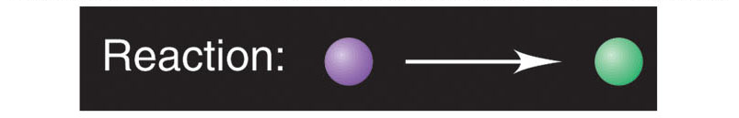
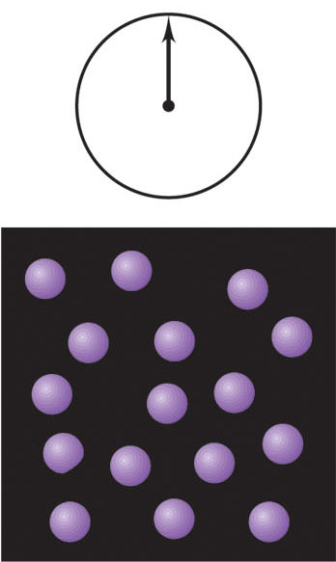
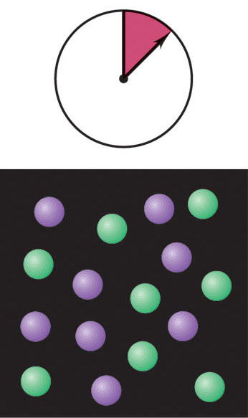
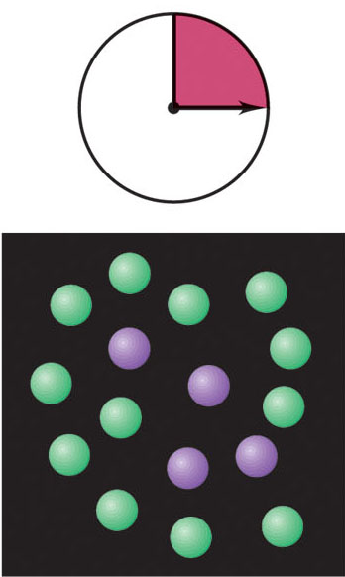
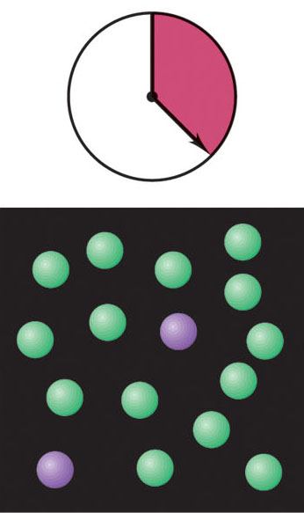
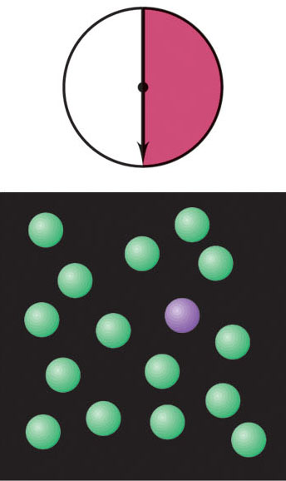

Reaction rate: the central focus of chemical kinetics
Figure 16.1
Copyright © The McGraw-Hill Companies, Inc. Permission required for reproduction or display.

Slide 4
Factors Influencing Reaction Rates
Reactant Concentration: molecular collisions are required for
reactions to occur
reaction rate α collision frequency α concentration
Physical State: molecules must mix to collide
When reactants are in different phases, the more finely divided
a solid or liquid reactant, the greater the surface area per unit
volume, the more contact it makes with other reactants,
and the faster the reaction.
Temperature: molecules must collide with sufficient energy to react
Higher T translates into more collisions per unit time and
into higher-energy collisions
reaction rate α collision energy α temperature

Slide 5
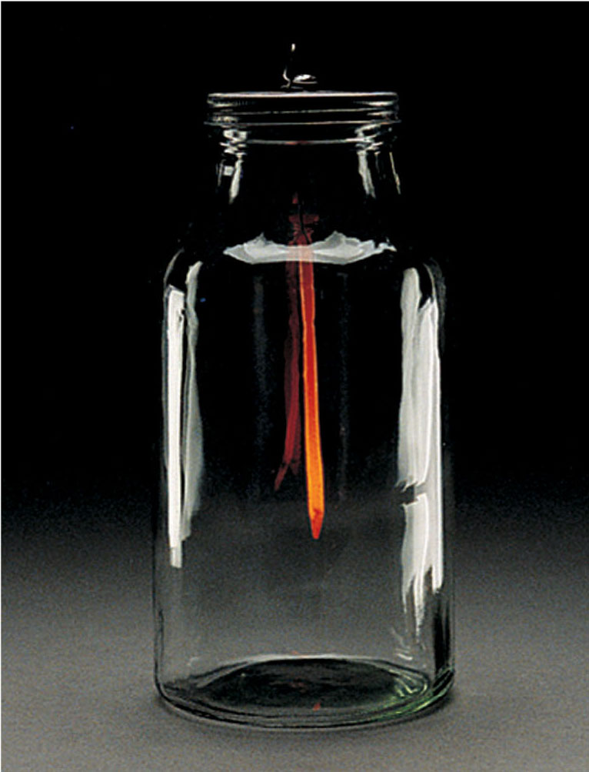
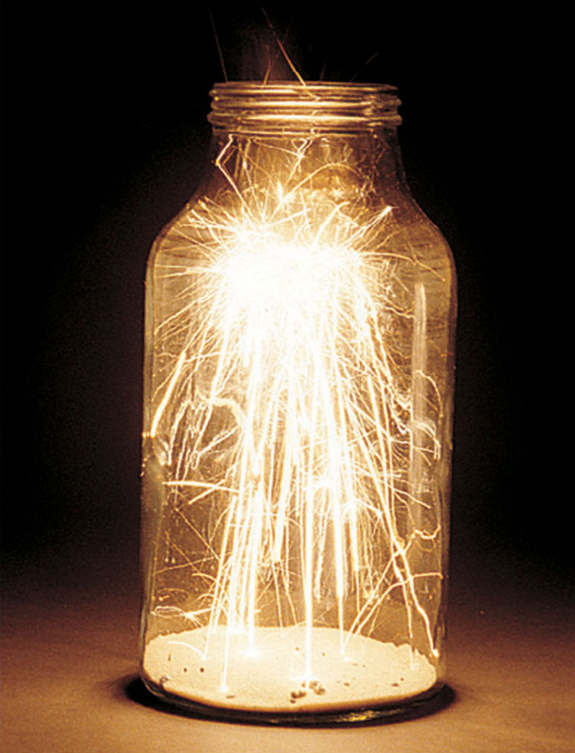
The effect of surface area on reaction rate
Copyright © The McGraw-Hill Companies, Inc. Permission required for reproduction or display.
Figure 16.3
steel nail in O₂
steel wool in O₂

Slide 6
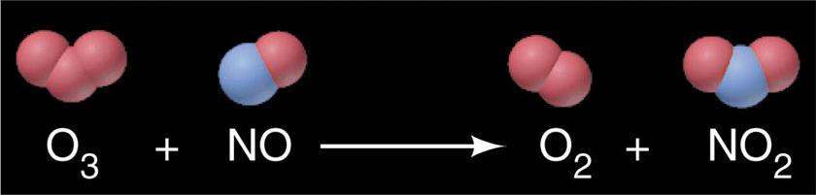
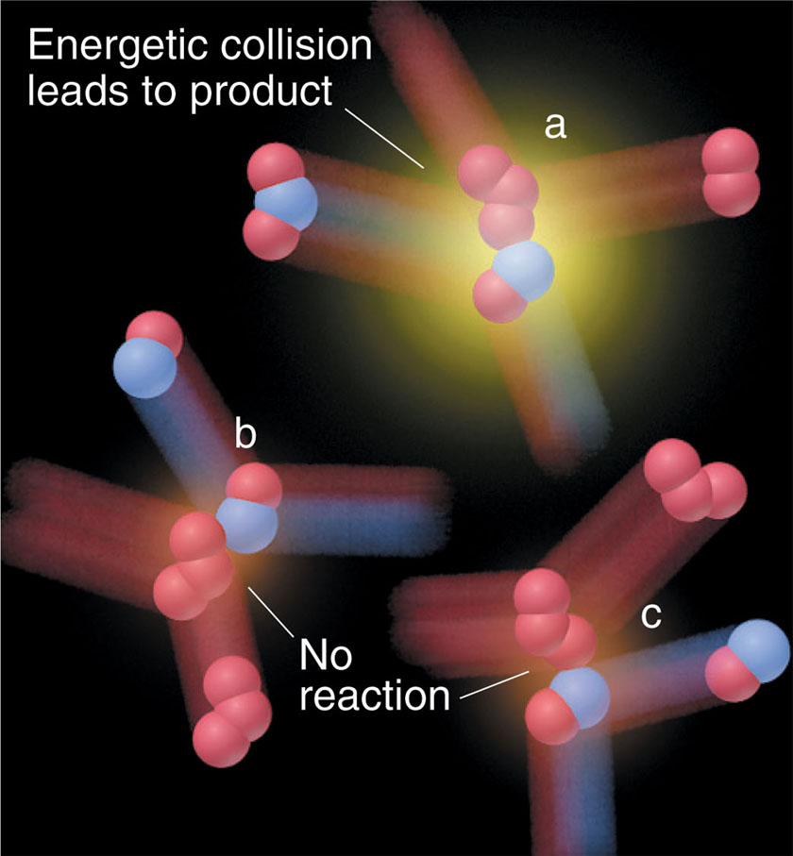
Copyright © The McGraw-Hill Companies, Inc. Permission required for reproduction or display.
Collision energy and reaction rate
Other factor: reaction
trajectory (not all collisions
with sufficient energy
are productive)
Figure 16.4

Slide 7
Expressing Reaction Rate
reaction rate = the changes in [reactants] or [products] per unit time;
[reactant] decreases, [product] increases
A B
Measure [A₁] at t₁, then measure [A₂] at t₂
Average rate of reaction = - ([A₂] - [A₁]) / (t₂ - t₁)
rate is always
expressed as a
positive value
= - Δ[A] / Δt
rate units = mol/L/s
Also, reaction rate = + Δ[B] / Δt

Slide 8
Table 16.1 Concentration of O₃ at various times in its reaction with C₂H₄ at 303 K
C
2
H
4
(
g
) + O
3
(
g
) C
2
H
4
O(
g
) + O
2
(
g
)
time (s)
concentration of O₃ (mol/L)
0.0
3.20 x 10⁻⁵
10.0
2.42 x 10⁻⁵
20.0
1.95 x 10⁻⁵
30.0
1.63 x 10⁻⁵
40.0
1.40 x 10⁻⁵
50.0
1.23 x 10⁻⁵
60.0
1.10 x 10⁻⁵
Copyright © The McGraw-Hill Companies, Inc. Permission required for reproduction or display.

Slide 9
Different Ways to Measure Reaction Rates
Reaction rate varies with time as the reaction proceeds!
C₂H₄(g) + O₃(g) C₂H₄O(g) + O₂(g)
average rate = - Δ[O₃] /Δt = - (1.10 x 10⁻⁵ mol/L) - (3.20 x 10⁻⁵ mol/L)
60.0 s - 0.0 s
= 3.50 x 10⁻⁷ mol/L/s
Similar calculations over earlier and later time intervals (e.g., 0.0 -10.0 s,
50.0 - 60.0 s) reveals average rates of 7.80 x 10⁻⁷ mol/L/s and
1.30 x 10⁻⁷ mol/L/s, respectively.
Data show that the average rate decreases as the
reaction proceeds!

Slide 10
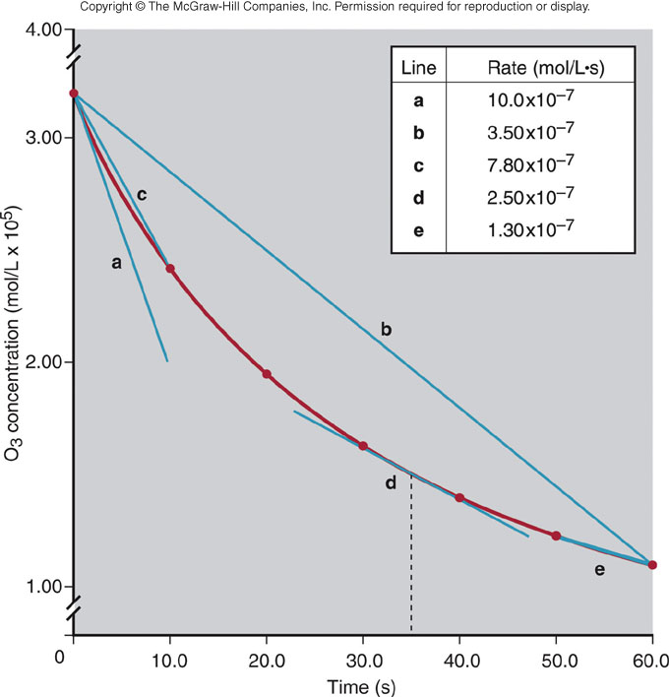
Concentrations of O₃ vs time during its reaction with C₂H₄
Curved line indicates change
in reaction rate with time.
The slope of a tangent at any
point on the curve yields the
instantaneous rate at that point.
reaction rate = (instantaneous)
reaction rate
initial rates: measured to avoid
complications due to back
reactions
Figure 16.5

Slide 11
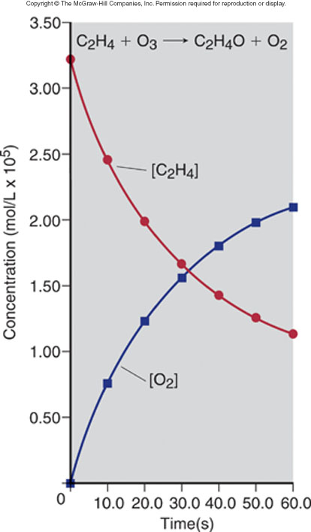
Other Plots to Determine
Reaction Rate
C₂H₄(g) + O₃(g) C₂H₄O(g) + O₂(g)
Plots of [C₂H₄] and [O₂] vs reaction time
Figure 16.6

Slide 12
Expressing rate in terms of changes in
[reactant] and [product]
H₂(g) + I₂(g) 2HI(g)
rate = - Δ[H₂]/Δt = - Δ[I₂]/Δt = 1/2 Δ[HI]/Δt
or
rate = Δ[HI]/Δt = -2 Δ[H₂]/Δt = -2 Δ[I₂]/Δt
The mathematical expression for the rate, and the numerical value of
the rate, depend on which substance is chosen as the reference.
For the general reaction: aA + bB cC + dD
rate = -1/a Δ[A]/Δt = -1/b Δ[B]/Δt = 1/c Δ[C]/Δt = 1/d Δ[D]/Δt

Slide 13
Sample Problem 16.1
Expressing rate in terms of changes in concentration with time
PROBLEM:
Because it generates a nonpolluting product (water vapor), hydrogen gas is used for fuel aboard the space shuttle and may be used by automobile engines in the near future.
2H₂(g) + O₂(g) 2H₂O(g)
(a) Express the rate in terms of changes in [H₂], [O₂], and [H₂O] with time.
(b) If [O₂] decreases at 0.23 mol/L/s, at what rate is [H₂O] increasing?
PLAN:
Choose [O₂] as the reference since its coefficient is 1. For every molecule of O₂ that disappears, two molecules of H₂ disappear and two molecules of H₂O appear, so [O₂] decreases at one-half the rates of change in [H₂] and [H₂O].
SOLUTION:
1
Δ[H₂]
Δ[O₂]
1
Δ[H₂O]
(a)
rate =
-
= -
= +
2
Δt
Δt
2
Δt
Δ[O₂]
1
Δ[H₂O]
Δ[H₂O]
(b)
-
=
0.23 mol/L.s
= +
; = 0.46 mol/L.s
Δt
2
Δt
Δt

Slide 14
The Rate Law
The rate law expresses the reaction rate as a function of reactant
concentrations, product concentrations, and temperature. It is
experimentally determined.
The derived rate law for a reaction must be consistent
with the postulated chemical mechanism of the reaction!
For a general reaction: aA + bB + ..... cC + dD
rate law: rate = k[A]^{m}[B]^{n}........
k = rate constant
m and n = reaction orders (not related to a, b,...)
(for a unidirectional (one-way) reaction)!

Slide 15
How is the rate law determined experimentally?
The Procedure
1. Measure initial rates (from concentration measurements)
2. Use initial rates from several experiments to find the reaction orders
3. Calculate the rate constant

Slide 16
Reaction Order Terminology
rate = k[A] first order overall (rate α [A])
rate = k[A]² second order overall (rate α [A]²)
rate = k[A]⁰ = k(1) = k zero order (rate independent of [A])
Examples
NO(g) + O₃(g) NO₂(g) + O₂(g)
rate = k[NO][O₃] second order overall
2NO(g) + 2H₂(g) N₂(g) + 2H₂O(g)
rate = k[NO]²[H₂]¹ third order overall

Slide 17
Properties of Reaction Orders
Reaction orders cannot be deduced from the
balanced chemical equation.
Reaction orders are usually positive integers or zero.
Reaction orders can be fractional or negative.

Slide 18
Determining Reaction Orders
O₂(g) + 2NO(g) 2NO₂
rate = k[O₂]^{m}[NO]^{n}
To find m and n: A series of experiments is conducted starting with different sets of reactant concentrations. The initial reaction rate is measured in each experiment.

Slide 19
Table 16.2 Initial rates in a series of experiments for the reaction between O₂ and NO
initial reactant concentrations (mol/L)
initial rate (mol/L.s)
experiment
O₂
NO
1
1.10 x 10⁻²
1.30 x 10⁻²
3.21 x 10⁻³
2
2.20 x 10⁻²
1.30 x 10⁻²
6.40 x 10⁻³
3
1.10 x 10⁻²
2.60 x 10⁻²
12.8 x 10⁻³
4
3.30 x 10⁻²
1.30 x 10⁻²
9.60 x 10⁻³
5
1.10 x 10⁻²
3.90 x 10⁻²
28.8 x 10⁻³
Copyright © The McGraw-Hill Companies, Inc. Permission required for reproduction or display.

Slide 20

Manipulating the Data
rate 2 k[O₂]₂^{m}[NO]₂^{n}
=
([NO] is held constant)
rate 1 k[O₂]₁^{m}[NO]₁^{n}
rate 2 [O₂]₂^{m}
=
=
([O₂]₂ / [O₁]₁)^{m}
rate 1 [O₂]₁^{m}
6.40 x 10⁻³ mol/L/s
=
(2.20 x 10⁻² mol/L/ 1.10 x 10⁻² mol/L)^{m}
3.21 x 10⁻³ mol/L/s
1.99 = (2.00)^{m}
m = 1
Thus, the reaction is first order with respect to O₂.
When [O₂] doubles, the rate doubles.

Slide 21
rate 3 k[O₂]₃^{m}[NO]₃^{n}
=
([O₂] is held constant)
rate 1 k[O₂]₁^{m}[NO]₁^{n}
via same manipulations as before:
3.99 = (2.00)^{n}
n = 2
Thus, the reaction is second order with respect to NO.
When [NO] doubles, the rate quadruples.
The rate law is: rate = k[O₂][NO]²
The reaction is third order overall.

Slide 22
Sample Problem 16.3
Determining reaction order from initial rate data
PROBLEM:
Many gaseous reactions occur in a car engine and exhaust system. One such reaction is as follows:
rate = k[NO₂]^{m}[CO]^{n}
Use the following data to determine the individual and overall reaction orders.
experiment
initial rate (mol/L.s)
initial [NO₂] (mol/L)
initial [CO] (mol/L)
1
0.0050
0.10
0.10
2
0.080
0.40
0.10
3
0.0050
0.10
0.20
PLAN:
Solve for each reactant using the general rate law by applying the method described previously.
SOLUTION:
rate = k [NO₂]^{m}[CO]^{n}
First, choose two experiments in which [CO] remains constant and [NO₂] varies.

Slide 23
Sample Problem 16.3
(continued)
rate 2
k [NO₂]^{m}₂[CO]^{n}₂
[NO₂] ₂
m
=
=
rate 1
k [NO₂]^{m}₁ [CO]^{n}₁
[NO₂] ₁
0.080
0.40
m
The reaction is 2nd order in NO₂.
=
;
16 = 4^{m} and m = 2
0.0050
0.10
rate 3
k [NO₂]^{m}₃[CO]^{n}₃
[CO] ₃
n
=
=
rate 1
k [NO₂]^{m}₁ [CO]^{n}₁
[CO] ₁
0.0050
0.20
n
The reaction is zero order in CO.
=
;
1 = 2^{n} and n = 0
0.0050
0.10
Rate Law: rate = k [NO₂]²[CO]⁰ = k [NO₂]²
The reaction is second order overall.

Slide 24
Determining the Rate Constant
The rate constant, k, is specific for a particular reaction
at a particular temperature.
k = rate 1 / ([O₂]₁[NO]₁²)
3.21 x 10⁻³ mol/L/s
=
1.73 x 10³ L²/mol²/s = k
1.86 x 10⁻⁶ mol³/L³
The units for k depend on the order of the reaction
and the time unit.

Slide 25
Table 16.3 Units of the rate constant, k, for several overall reaction orders
overall reaction order
units of k (t in seconds)
0
mol/L.s (or mol L⁻¹ s⁻¹)
1
1/s (or s⁻¹)
2
L/mol . s (or L mol⁻¹ s⁻¹)
3
L² / mol^{2 .}s (or L² mol⁻² s⁻¹)
Copyright © The McGraw-Hill Companies, Inc. Permission required for reproduction or display.

Slide 26
Integrated Rate Laws: Change in Concentration
with Reaction Time
Consider a general first order reaction: A B
rate = - Δ[A]/Δt = k[A]
Upon integration over time, we obtain:
ln ([A]₀/[A]_{t}) = kt
ln = natural logarithm
[A]₀ = concentration of A at t = 0
[A]_{t} = concentration of A at any time t
ln [A]₀ - ln [A]_{t} = kt

Slide 27
For a simple second order reaction (one reactant only):
rate = - Δ[A]/Δt = k[A]²
Upon integration over time, we obtain:
1/[A]_{t} - 1/[A]₀ = kt
For a zero order reaction:
rate = - Δ[A]/Δt = k[A]⁰
Upon integration over time, we obtain:
[A]_{t} - [A]₀ = -kt

Slide 28

Sample Problem 16.4
Determining reaction concentration at a given time
PROBLEM:
At 1000 ºC, cyclobutane (C₄H₈) decomposes in a first-order reaction with the very high rate constant of 87 s⁻¹ to yield two molecules of ethylene (C₂H₄).
(a) If the initial [C₄H₈] is 2.00 M, what is the concentration after 0.010 s of reaction?
(b) What fraction of C₄H₈ has decomposed in this time?
PLAN:
Find [C₄H₈] at time t using the integrated rate law for a 1st-order reaction. Once that value is found, divide the amount decomposed by the initial concentration.
SOLUTION:
[C₄H₈]₀
2.00 M
ln
; ln
= (87 s⁻¹)(0.010 s)
= kt
= 0.87
(a)
[C₄H₈]_{t}
[C₄H₈]_{t}
2.00 M / [C₄H₈]_{t} = e^{0.87} = 2.4
[C₄H₈]_{t} = 0.83 M
(b)
[C₄H₈]₀ - [C₄H₈]_{t}
2.00 M - 0.83 M
=
= 0.58
[C₄H₈]₀
2.00 M

Slide 29
Reaction Order from the Integrated Rate Law
Graphical methods to determine reaction orders
(when you don’t have initial rate data!)
Rearranged integrated rate laws:
ln [A]_{t} = -kt + ln [A]₀
first order reaction
1/[A]_{t} = kt + 1/[A]₀
simple second order reaction
[A]_{t} = -kt + [A]₀
zero order reaction
All take the form: y = mx + b

Slide 30
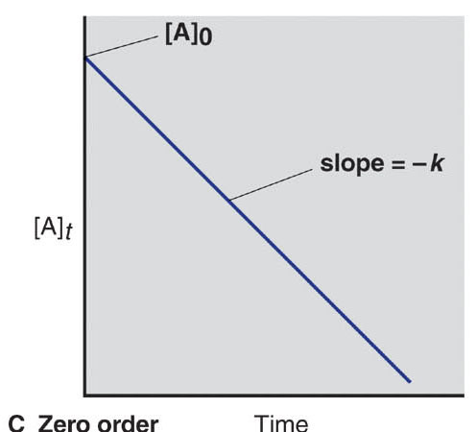
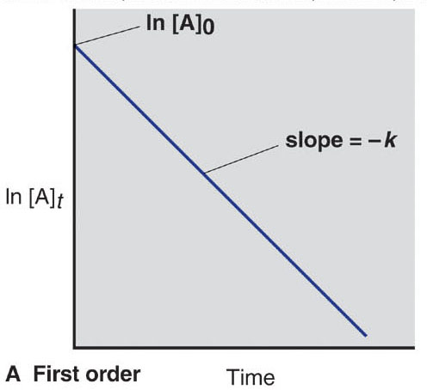
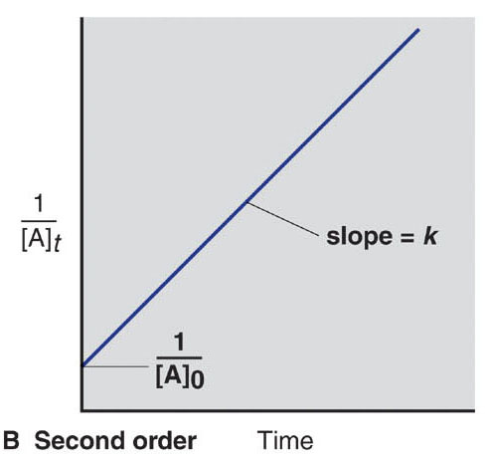
Graphical method to determine reaction order
[A]_{t} = -kt + [A]₀
ln[A]_{t} = -kt + ln[A]₀
1/[A]_{t} = kt + 1/[A]₀
Figure 16.7

Slide 31
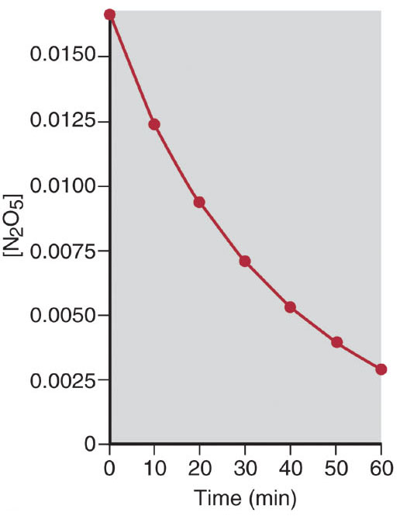
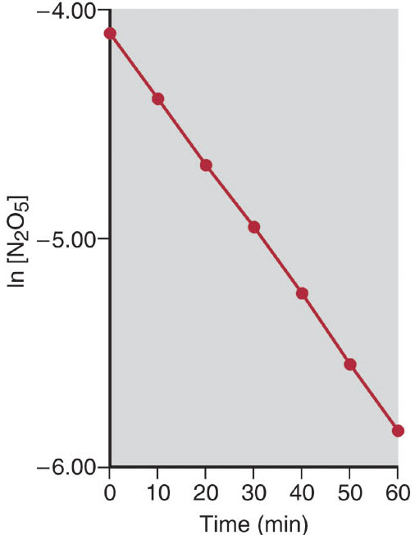
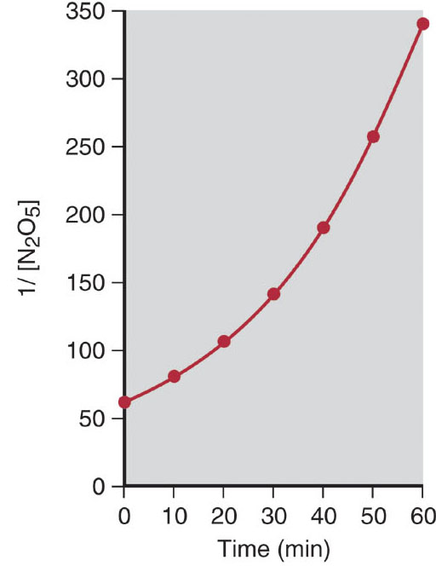
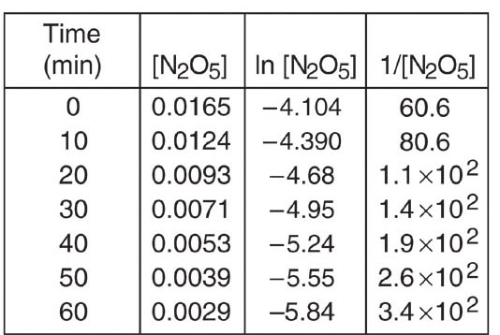
Graphical determination of the reaction order for the
decomposition of N₂O₅
nonlinear
linear!
nonlinear
Figure 16.8

Slide 32
Conclusion
For the decomposition of N₂O₅......
the reaction must be first order in N₂O₅.
Graphical approach can likewise be applied to reactions
involving multiple reactants.

Slide 33
Reaction Half-Life
Just another way to express the speed of a reaction
half-life (t_{1/2}) = the time required for the reactant concentration
to reach one-half of its initial value
For a first order reaction at fixed conditions: t_{1/2} is a constant,
independent of reactant concentration

Slide 34
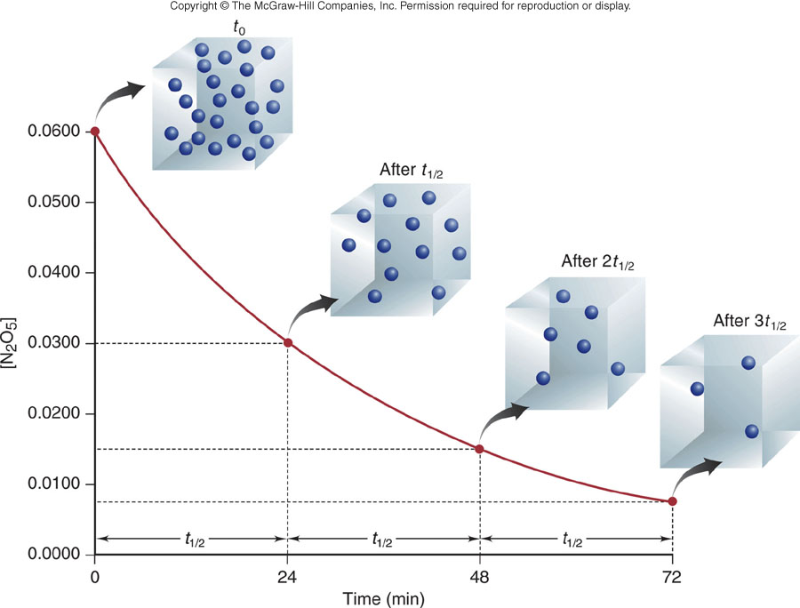
A plot of [N₂O₅] vs time for three half-lives
A first order
reaction
Figure 16.9

Slide 35
Why is t_{1/2} independent of reactant concentration
for a first order reaction?
ln ([A]₀/[A]_{t}) = kt
After one half-life, t = t_{1/2} and [A]_{t} = 0.5[A]₀. Substituting.....
ln ([A]₀/0.5([A]₀) = kt_{1/2}
or
ln 2 = kt_{1/2}
t_{1/2} = (ln 2)/k = 0.693/k
first order reaction: A B

Slide 36
Sample Problem 16.5
Determining the half-life of a first-order reaction
PROBLEM:
Cyclopropane is the smallest cyclic hydrocarbon. Because its 60º bond angles allow poor orbital overlap, its bonds are weak. As a result, it is thermally unstable and rearranges to propene at 1000 ºC via the following first-order reaction:
C
H
2
Δ
H
C
C
H
C
H
(
)
(
)
g
H
C
C
H
g
3
2
2
2
The rate constant is 9.2 s⁻¹. (a) What is the half-life of the reaction? (b) How long does it take for [cyclopropane] to reach one-quarter of its initial value?
0.693
PLAN:
Use the half-life equation, t_{1/2} =
, to find the half-life.
k
One-quarter of the initial value means two half-lives have passed.
SOLUTION:
(a)
t_{1/2} = 0.693 / 9.2 s⁻¹ = 0.075 s
(b)
2 t_{1/2} = 2 (0.075 s) = 0.15 s

Slide 37
Half-Life for Zero and Second Order Reactions
t_{1/2} = 1/k [A]₀
simple second order (rate = k[A]²)
As a second order reaction proceeds, the half-life increases.
t_{1/2} = [A]₀/2k
zero order (rate = k)
For zero order reactions, higher initial reactant concentrations
translate into longer half-lives.

Slide 38
Table 16.4 An overview of zero-order, first-order and simple second-order reactions
zero order
first order
second order
rate law
rate = k
rate = k[A]
rate = k[A]²
units for k
mol/L.s
1/s
L/mol.s
integrated rate law in straight-line form
[A]_{t} =
kt + [A]₀
ln[A]_{t} =
-kt + ln[A]₀
1/[A]_{t} =
kt + 1/[A]₀
plot for straight line
[A]_{t} vs t
ln[A]_{t} vs t
1/[A]_{t} = t
slope, y-intercept
-k, [A]₀
-k, ln[A]₀
k, 1/[A]₀
half-life
[A]₀/2k
(ln 2)/k
1/k[A]₀
Copyright © The McGraw-Hill Companies, Inc. Permission required for reproduction or display.

